Slide 1
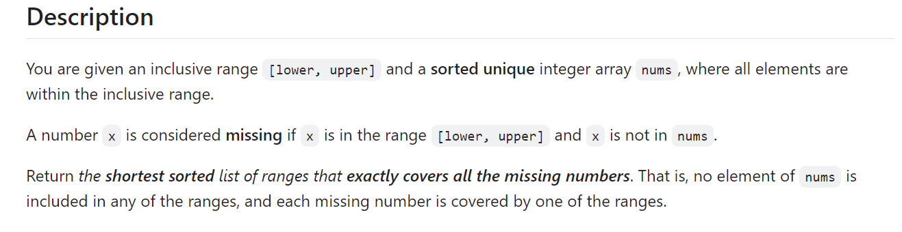
Level of Problem - : Easy
Topics Include -: Arrays
Company Tags -: Facebook 8
163. Missing Ranges 🔒

Slide 2
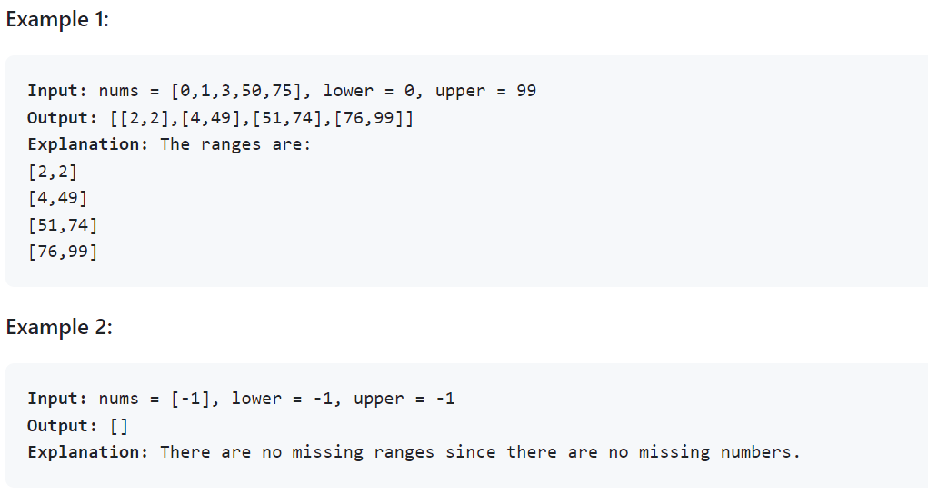
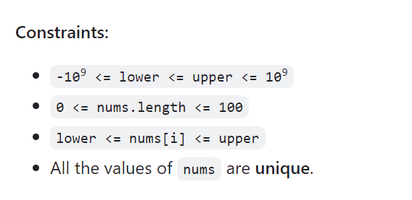

Slide 3
Solutions - :
Python
class Solution:
def findMissingRanges(
self, nums: List[int], lower: int, upper: int
) -> List[List[int]]:
n = len(nums)
if n == 0:
return [[lower, upper]]
ans = []
if nums[0] > lower:
ans.append([lower, nums[0] - 1])
for a, b in pairwise(nums):
if b - a > 1:
ans.append([a + 1, b - 1])
if nums[-1] < upper:
ans.append([nums[-1] + 1, upper])
return ans

Slide 4
Java
class Solution {
public List<List<Integer>> findMissingRanges(int[] nums, int lower, int upper) {
int n = nums.length;
if (n == 0) {
return List.of(List.of(lower, upper));
}
List<List<Integer>> ans = new ArrayList<>();
if (nums[0] > lower) {
ans.add(List.of(lower, nums[0] - 1));
}
for (int i = 1; i < n; ++i) {
if (nums[i] - nums[i - 1] > 1) {
ans.add(List.of(nums[i - 1] + 1, nums[i] - 1));
}
}
if (nums[n - 1] < upper) {
ans.add(List.of(nums[n - 1] + 1, upper));
}
return ans;
}
}

Slide 5
C++
class Solution {
public:
vector<vector<int>> findMissingRanges(vector<int>& nums, int lower, int upper) {
int n = nums.size();
if (n == 0) {
return {{lower, upper}};
}
vector<vector<int>> ans;
if (nums[0] > lower) {
ans.push_back({lower, nums[0] - 1});
}
for (int i = 1; i < nums.size(); ++i) {
if (nums[i] - nums[i - 1] > 1) {
ans.push_back({nums[i - 1] + 1, nums[i] - 1});
}
}
if (nums[n - 1] < upper) {
ans.push_back({nums[n - 1] + 1, upper});
}
return ans;
}
};

